Slide 1

Object-Oriented Programming: Semester Project
Presented by Muhammad Umer Khan to Professor Mam Ayesha Sarwar.
This presentation outlines the development and key features of our web-based chat application, built as a semester project in Object-Oriented Programming.

Slide 2
Project Overview: A Web-Based Chat Application
This project delivers a fully functional web-based chat application, designed to demonstrate core OOP principles and practical web development skills. It leverages Streamlit for the user interface and a custom-built storage layer for data persistence.
1
Core Functionality
2
Architecture
Secure User Authentication (Sign up / Log in)
Frontend: Streamlit (app.py)
Private (DM) and Group Chat Capabilities
Backend/Data: Custom Storage Class (storage.py)
Rich Message Support (Text & Images)
Data Persistence: JSON Files
Automatic Message Refresh for Real-time Updates

Slide 3
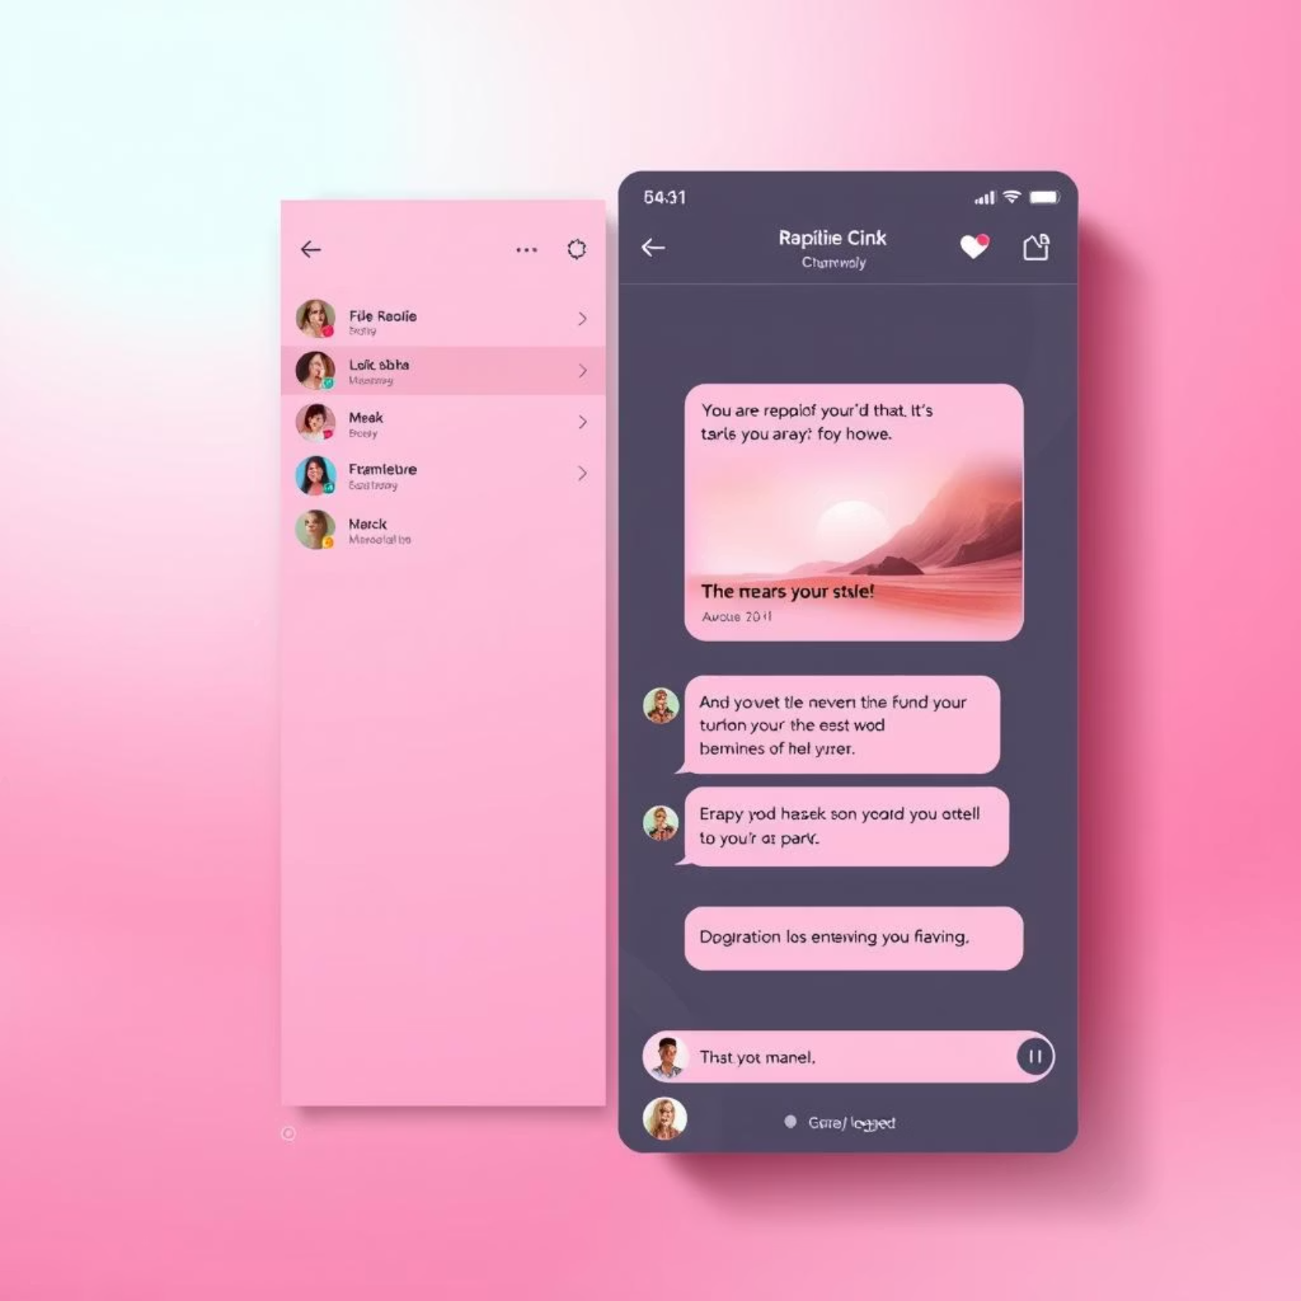
Frontend: app.py - The User Interface
The app.py script is the heart of the user experience, providing the interactive interface and handling all client-side interactions.
Streamlit UI Configuration: Sets up the page layout and title for a wide, engaging display.
User Authentication Views: Dedicated sections for secure login and new user sign-up, ensuring robust account creation and verification.
Sidebar Navigation: Intuitive sidebar displaying the current user, logout options, auto-refresh toggle, and a dynamic list of active chats. Users can also initiate new direct messages or group chats from here.

Slide 4
Frontend: app.py - Dynamic Chat Experience
1
2
Chat View & Rendering
Message Composition
Displays chat details including participants and all messages. The render_message() function ensures proper formatting for text and image content, complete with sender names and timestamps.
Users can send messages via a text input box and upload images directly through an integrated file uploader. This enables rich communication within chats.
3
4
Auto-Refresh Mechanism
Main Execution Flow
Messages automatically refresh every 3 seconds, providing a near real-time chat experience without manual intervention. This keeps conversations fluid and up-to-date.
The application intelligently checks user login status. Authenticated users are directed to the main chat interface, while unauthenticated users are presented with login/signup forms.

Slide 5




Backend: storage.py - The Data Engine
The storage.py module serves as the robust backend, managing all persistent data for user accounts, chats, and messages. It utilizes a file-based JSON storage system for simplicity and portability.
Organized Data Structure
Comprehensive User Management
A clear directory structure (data/users/, data/chats/, data/images/) ensures efficient organization and retrieval of all application data.
Functions for listing, checking existence, creating, verifying, and retrieving user details ensure secure and efficient user lifecycle management.
Dynamic Chat Management
Robust Image Handling
Handles the creation of both private and group chats, lists user-specific chats, retrieves full chat histories, and appends new messages seamlessly.
Manages saving uploaded image bytes to disk and converting images to Base64 data URLs for efficient embedding directly within chat messages.

Slide 6

Security Measures: Protecting User Data
Security is paramount in any application handling user data. Our backend implements crucial measures to protect sensitive information, particularly user passwords.
Password Hashing
User passwords are never stored in plaintext. Instead, they are cryptographically hashed using SHA-256 before being saved.
Salted Passwords
To further enhance security against rainbow table attacks, a unique "salt" is added to each password before hashing. This makes each hash unique, even for identical passwords.
Secure Verification
During login, the provided password is salted and hashed with the stored salt, then compared against the stored hash, ensuring only legitimate users can access their accounts.

Slide 7





Key Technical Highlights: Innovation in Practice
This project showcases several technical strengths, demonstrating robust implementation and thoughtful design choices.
Stateless Session Management
Utilizes Streamlit's st.session_state for efficient tracking of logged-in users and active chats, maintaining application state across interactions.
Efficient Auto-Refresh
Implemented using time.sleep(3) and st.rerun(), providing near real-time updates for messages and ensuring a dynamic chat environment.
Human-Readable Persistence
All data is stored in well-structured JSON files, making debugging straightforward and the application data highly portable across different environments.
Robust Password Security
Integration of salting and SHA-256 hashing ensures that user passwords are securely stored, preventing direct exposure and unauthorized access.
Cross-Platform Compatibility
With no external database dependencies, the application is designed to run seamlessly on any machine equipped with Python and Streamlit, enhancing accessibility.

Slide 8

Object-Oriented Design Principles
The project's architecture heavily relies on core Object-Oriented Programming (OOP) principles, ensuring maintainability, scalability, and reusability.
Encapsulation: The Storage class encapsulates all data persistence logic, hiding implementation details from the frontend.
Abstraction: Users interact with simplified interfaces (e.g., create_user(), append_message()) without needing to understand underlying file operations.
Modularity: Separation into app.py and storage.py allows independent development and easier debugging of frontend and backend components.
Code Reusability: Functions within storage.py are designed to be generic and reusable across different parts of the application, minimizing redundant code.
Maintainability: The clear separation of concerns and adherence to OOP principles make the codebase easier to understand, modify, and extend in the future.

Slide 9
Potential Future Improvements
While the current application is robust, several enhancements could elevate its functionality and performance for a production environment.
Database Integration
Real-time Communication
Transition from JSON files to a more scalable database solution (e.g., SQLite, PostgreSQL) to handle larger data volumes and concurrent access.
Implement WebSockets instead of polling for auto-refresh, enabling true real-time message updates and reducing server load.
Enhanced Chat Features
Scalability & Performance
Add message search functionality.
Optimize image storage and delivery, potentially using a dedicated media server or cloud storage for large files.
Introduce user typing indicators.
Implement read receipts for messages.

Slide 10

Thank You!
Questions & Discussion
We appreciate your time and attention to our project. We are ready to discuss any aspects of our chat application and its development.

